Slide 1


Slide 2


Smart Carbon Track
Second Year Project Progress
Submitted by
ROLL | NAME
2401730141 | Priya Shukla
2401730136 | Neha Kumari Singh
2401730046 | Sarah Henry
2401730080 | Khushboo
2401730119 | Priya Bora
2401730133 | Ridhima Singh
Industry Mentor: Mohit Mahajan
Faculty Mentor: Dr. Shahjad
Notes:
New Courses replaced with New Programmes

Slide 3

Project Overview
Smart CarbonTrack is a digital platform designed to monitor, analyze, and reduce carbon emissions in manufacturing units.
It collects data from energy consumption, production processes, and operational activities.
The system converts this data into measurable carbon emissions using standard calculation methods.
It provides visual insights through dashboards to help industries understand their environmental impact.
The main goal is to support industries in making sustainable and eco-friendly decisions.
Notes:
New Courses replaced with New Programmes

Slide 4
Specific Objectives
Data Collection: Digitally gather monthly power, fuel, and production data.
Emission Calculation: Compute carbon emissions using standard factors.
KPI Generation: Generate key indicators like carbon intensity, RE%, and energy ratio.
Trend Visualization: Display emission trends and performance gaps via interactive dashboards.
Monthly Comparison: Track month-over-month progress against targets.
Decision Support: Enable data-driven actions to reduce carbon footprint.
Notes:
New Courses replaced with New Programmes

Slide 5
Key Features
Monthly Data-Based System- Uses existing energy, fuel, and production data without requiring new sensors or IoT devices.
Automated Co₂ Calculations- Converts raw inputs into total energy (MJ) and carbon emissions (Kg CO₂) using emission factors.
KPI Generation & Validation- Calculates carbon intensity, RE %, and EUR; compares with baseline & targets.
Carbon Credit Estimation- Estimates avoided CO₂ when performance improves over baseline, supporting credit reporting.
Secure & Immutable Records- Maintains tamper-proof monthly records for audit trails, compliance, and historical tracking.
Decision Support- Identifies performance gaps and provides actionable insights for emission reduction.
Notes:
New Courses replaced with New Programmes

Slide 6
Progress Summary
Conducted detailed research on carbon emission tracking systems and sustainability practices.
Completed literature review including GHG Protocol and emission standards.
Identified required data such as energy consumption and production metrics.
Designed initial system architecture and workflow.
Developed frontend interface using React.js.
Designed dashboard & analytics page.
Integrated charting tools (ApexCharts) for data visualization.
Implemented basic emission calculation logic and tested with sample data and connect the backend.
Notes:
New Courses replaced with New Programmes

Slide 7
Detailed Progress – Development Phase
Frontend Development:
Designed user-friendly interface using React components.
Implemented charts and graphs for better visualization of emission data.
Developed dashboard & analytic page.
Backend/Logic Development:
Developed formulas to calculate carbon emissions from input data and connect it.
REST API endpoints defined.
Processed and structured data for accurate analysis.
System Integration:
Connected data inputs with visualization components.
Tested system functionality and improved performance.
Emission factor dataset integrated.
Notes:
New Courses replaced with New Programmes

Slide 8
Methodology
User data input
User enters plant details, electricity (kWh), fuel types & quantities, and production volume via the web interface.
Data Validation
System validates all inputs for completeness, format, and range. Invalid entries are flagged before processing.
Emission Calculation
CO₂ is computed using predefined emission factors: Grid × 0.735 | HSD × 2.754 | LPG × 2.920 | PNG × 1.885 | Biomass × 0.0018
KPI Generation
Dashboard Visualization
Carbon Intensity (Kg CO₂/Ltr), RE %, and Energy Ratio (EUR) are derived from total emissions and production data.
Results are displayed as charts, trend graphs, and KPI cards in an interactive React.js dashboard.
Notes:
New Courses replaced with New Programmes

Slide 9
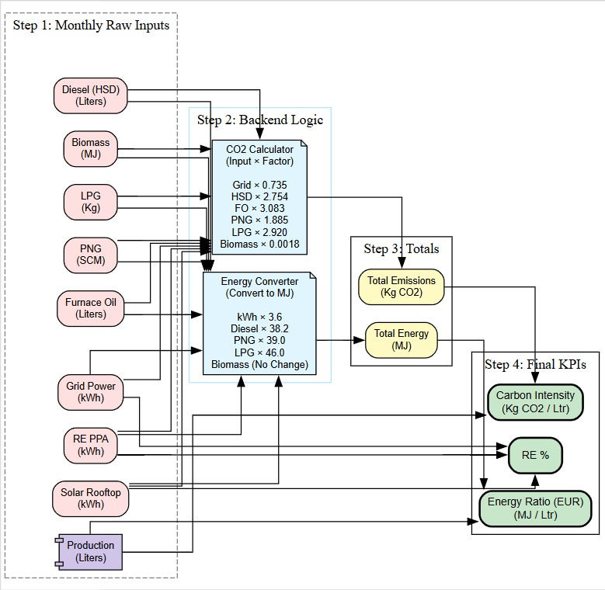

Prototype/Project Flow diagram/Architecture
Notes:
New Courses replaced with New Programmes

Slide 10
Prototype/Project Flow diagram/Architecture
Step 1
Monthly Raw Inputs
Diesel, Biomass, LPG, PNG, Furnace Oil, Grid Power, RE PPA, Solar, Production
Step 2
Backend logic
CO₂ Calculator (Input × Factor) + Energy Converter (to MJ)
Step 3
Totals Computed
Total Emissions (Kg CO₂) and Total Energy (MJ) aggregated
Step 4
Final KPIs
Carbon Intensity, RE %, and Energy Ratio (EUR) computed for dashboard
Notes:
New Courses replaced with New Programmes

Slide 11
Project Timeline
Phase / Activity | Month 1 | Month 2 | Month 3 | Month 4
Requirement Analysis | █
Literature Review | █ | █
Coding (Frontend + Backend) |  | █ | █
Testing & Debugging |  |  | █ | █
Final Report |  |  |  | █
Notes:
New Courses replaced with New Programmes

Slide 12
Next Steps and Goals
Finalize backend API for all calculation endpoints.
Complete user authentication & access control.
Develop Report Page for generating and viewing monthly/annual emission reports.
Create Settings Page to manage user profile, preferences, and thresholds.
Integrate download/export functionality for reports (PDF/Excel).
Conduct internal unit testing on calculation engine.
Notes:
New Courses replaced with New Programmes

Slide 13
Data & Resources
Input data Sources:
Monthly electricity consumption (kWh) — Grid, RE PPA, Solar Rooftop
Fuel consumption: Diesel (HSD), LPG, PNG (SCM), Furnace Oil, Biomass (MJ)
Production quantity (Liters / Units / Tons per month)
Historical baseline data for comparison & target setting
Plant metadata: name, location, sector, production type
Emission factor used:
Grid Electricity: 0.735 Kg CO₂/kWh
HSD (Diesel): 2.754 Kg CO₂/Ltr
LPG: 2.920 Kg CO₂/Kg
PNG: 1.885 Kg CO₂/SCM
Biomass: 0.0018 Kg CO₂/MJ
Technology used:
Frontend
Angular
Backend
Node js
Database
MongoDB
Charts
ApexCharts
Auth
JSON Web Tokens (JWT)
Dev tools
VS Code, Git
Notes:
New Courses replaced with New Programmes

Slide 14
Project Usecases & Scope
Can be used by manufacturing industries to monitor and control carbon emissions.
Performance comparison against baseline and internal targets.
Identification of high-emission processes and fuel types.
Estimation of carbon credits from improvement over baseline.
Helpful for environmental agencies to track industrial pollution levels.
Useful for companies aiming to achieve sustainability goals and certifications.
The system can be expanded to include different sectors like transportation and energy.
Future scope includes integration with smart devices and large-scale deployment.
Notes:
New Courses replaced with New Programmes

Slide 15
Expected Results & Impact
Accurate monthly carbon footprint per unit.
Clear visibility of energy & emission performance.
Identification of high-emission sources.
Support for compliance & sustainability reporting.
Drives sustainable manufacturing practices.
Reduces dependency on costly manual tracking.
Enables data-driven energy efficiency decisions.
Supports reduction of environmental impact through informed decisions.
Notes:
New Courses replaced with New Programmes

Slide 16
THANK YOU

